Slide 1
Nuclear iSupplier - New Registration Process
August 2016

Slide 2
Process for New Suppliers
Create SSO Login Account
Enter Company and Site details
Request Nuclear iSupplier Access
Go to
https://registration.gepower.com/registration/#/signin
Create SSO login Account & enter personal information (First Name, Last Name, Email address & Password Challenge question)
Email confirmationn will be sent to supplier
Enter your organization /company details
Verify and update site level details
Request “Nuclear_iSupplier_Access” by selecting the correct application
Email confirmation will be sent to Supplier for request
Email will be sent to supplier once the access is granted

Slide 3
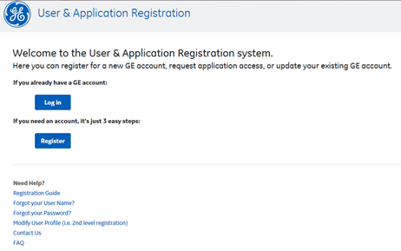
Step 1: Register to get SSO login id & Password
Log into URL: https://registration.gepower.com/registration/#/signin
Click to Register

Slide 4
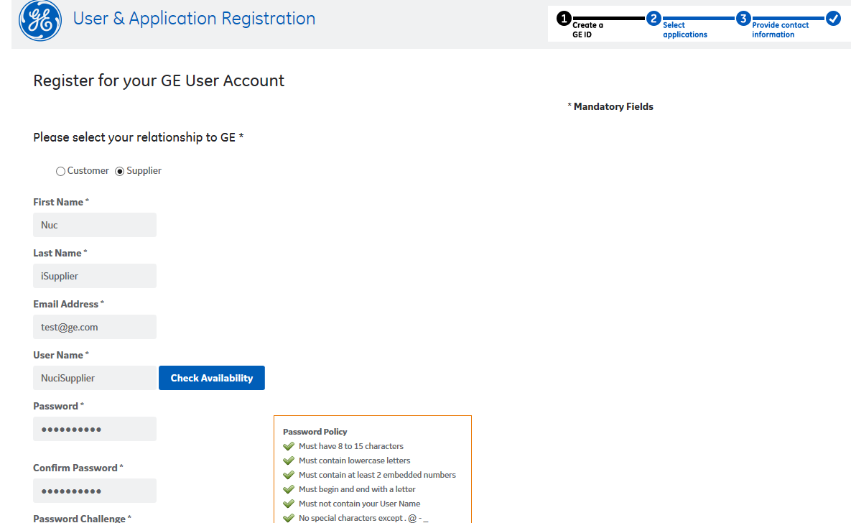
Click on Supplier
Enter First and Last name, Email Address, check username availability and make up password that adheres to Password Policy

Slide 5
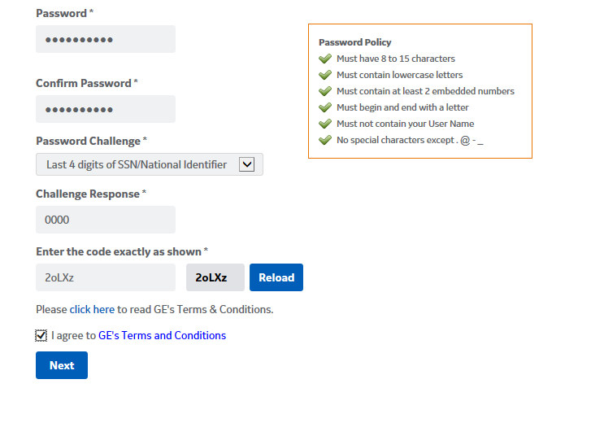
Create and Confirm a Strong Password.
Choose a Password Challenge question and Challenge Response. Enter code in box below
Click Agree
Click Next

Slide 6
Click on Nuclear_iSupplier_Access

Slide 7
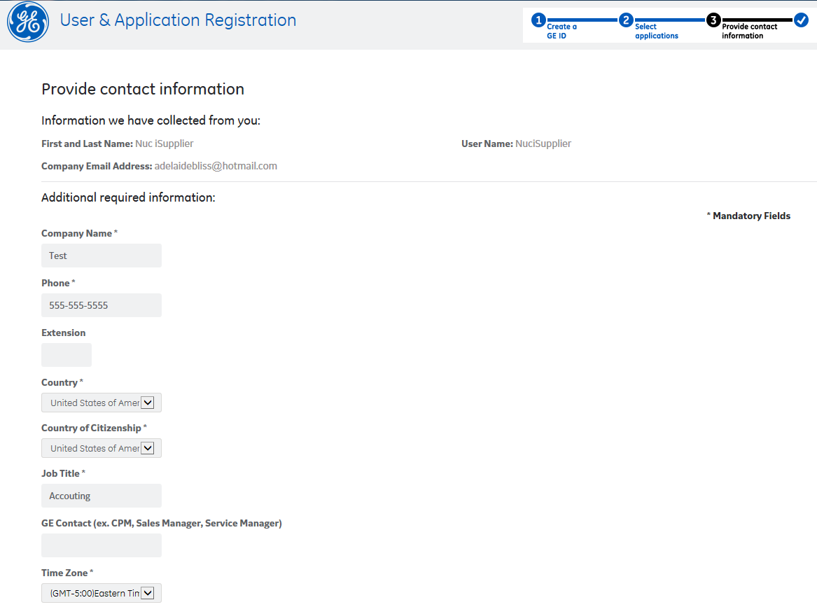
Enter Company Name, Phone number, Country, County of Citizenship, Job Title and Time Zone

Slide 8
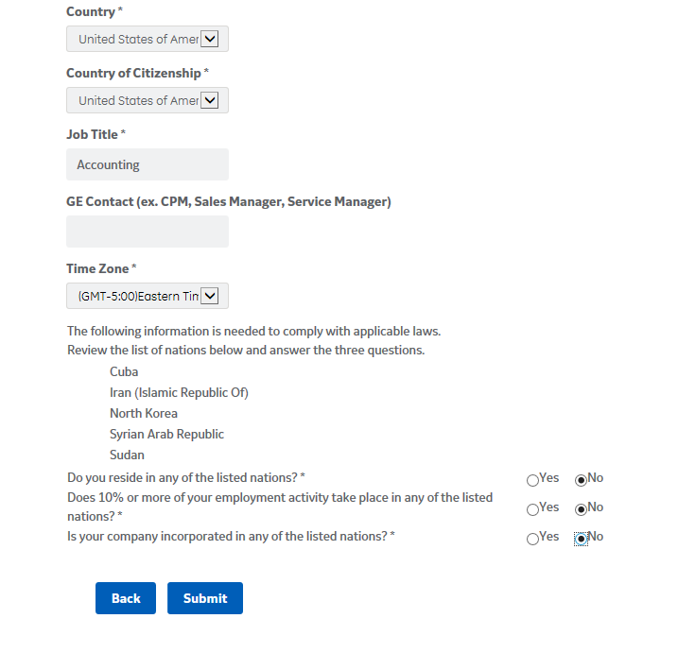
Answer Yes/No Questions below
Click Submit

Slide 9
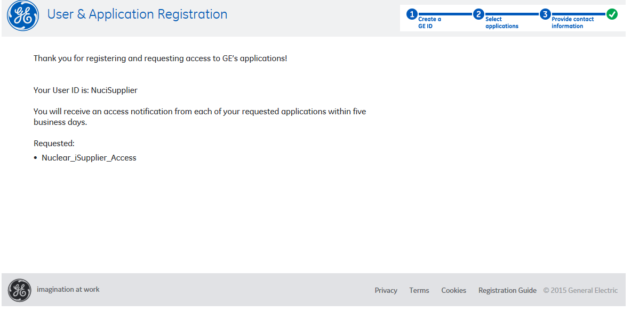

Slide 10
Supplier will be notified via email once the access is granted by iSupplier system admin
If you don’t receive the access approval mail in 5 days or have any other questions please write to us at: Nuclear.BuyDesk@ge.com

Slide 11
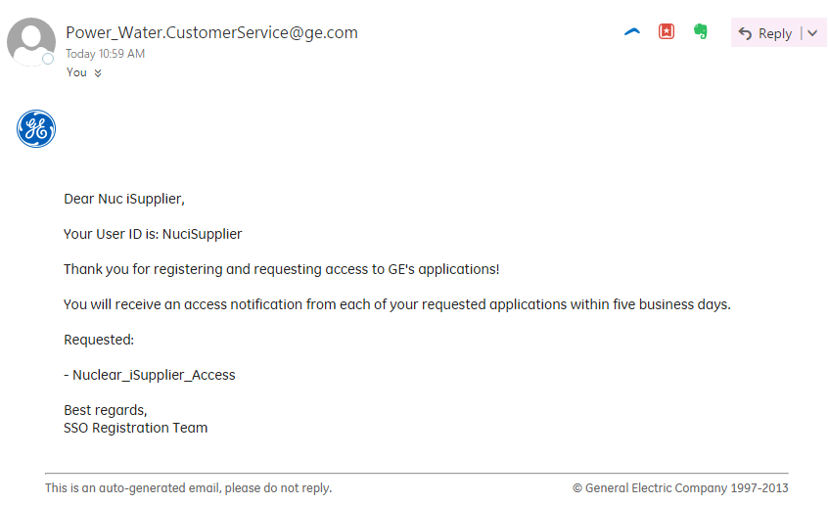
Initial Registration Emails

Slide 12
Thank you!
If you have any questions please send your query to : Nuclear.BuyDesk@ge.com.
Escalation Path
Send a mail to Nuclear.BuyDesk@ge.com
1st Level manuel.A.alvarez@ge.com
2nd Level James.Woodard@ge.com

